Slide 1
Generative Adversarial Networks
GANs for Computer Vision
Mastering the art of machine imagination — how adversarial training is reshaping visual intelligence

Slide 2
Contents
01
02
What are Generative Models
Introduction to GANs
03
04
GANs for Computer Vision
Applications of GANs in Computer Vision
05
06
DCGAN Model
SRGAN and ESRGAN Models

Slide 3
What Are Generative Models?
Generative models are designed to learn the underlying probability distribution of a dataset, enabling them to generate new data that preserves univariate properties, multivariate relationships, and correlation structures observed in the original data.
What They Learn
What They Generate
Discriminative vs Generative
Data distributions: univariate, multivariate, and correlation patterns
Images, text, audio, and rare-event structured data
Discriminative models classify; generative models learn to produce new samples
In other words, Generative models learn the data distribution and generate new samples that retain statistical properties such as
distributions and correlations.

Slide 4
Introduction to GANs
Generative Adversarial Networks were proposed by Ian Goodfellow in 2014, introducing a revolutionary framework
for generative modeling.
Two Networks
Key Idea: Competition
A Generator and a Discriminator work in opposition to each other
The two networks compete against each other, driving both to improve over time through adversarial training

Slide 5
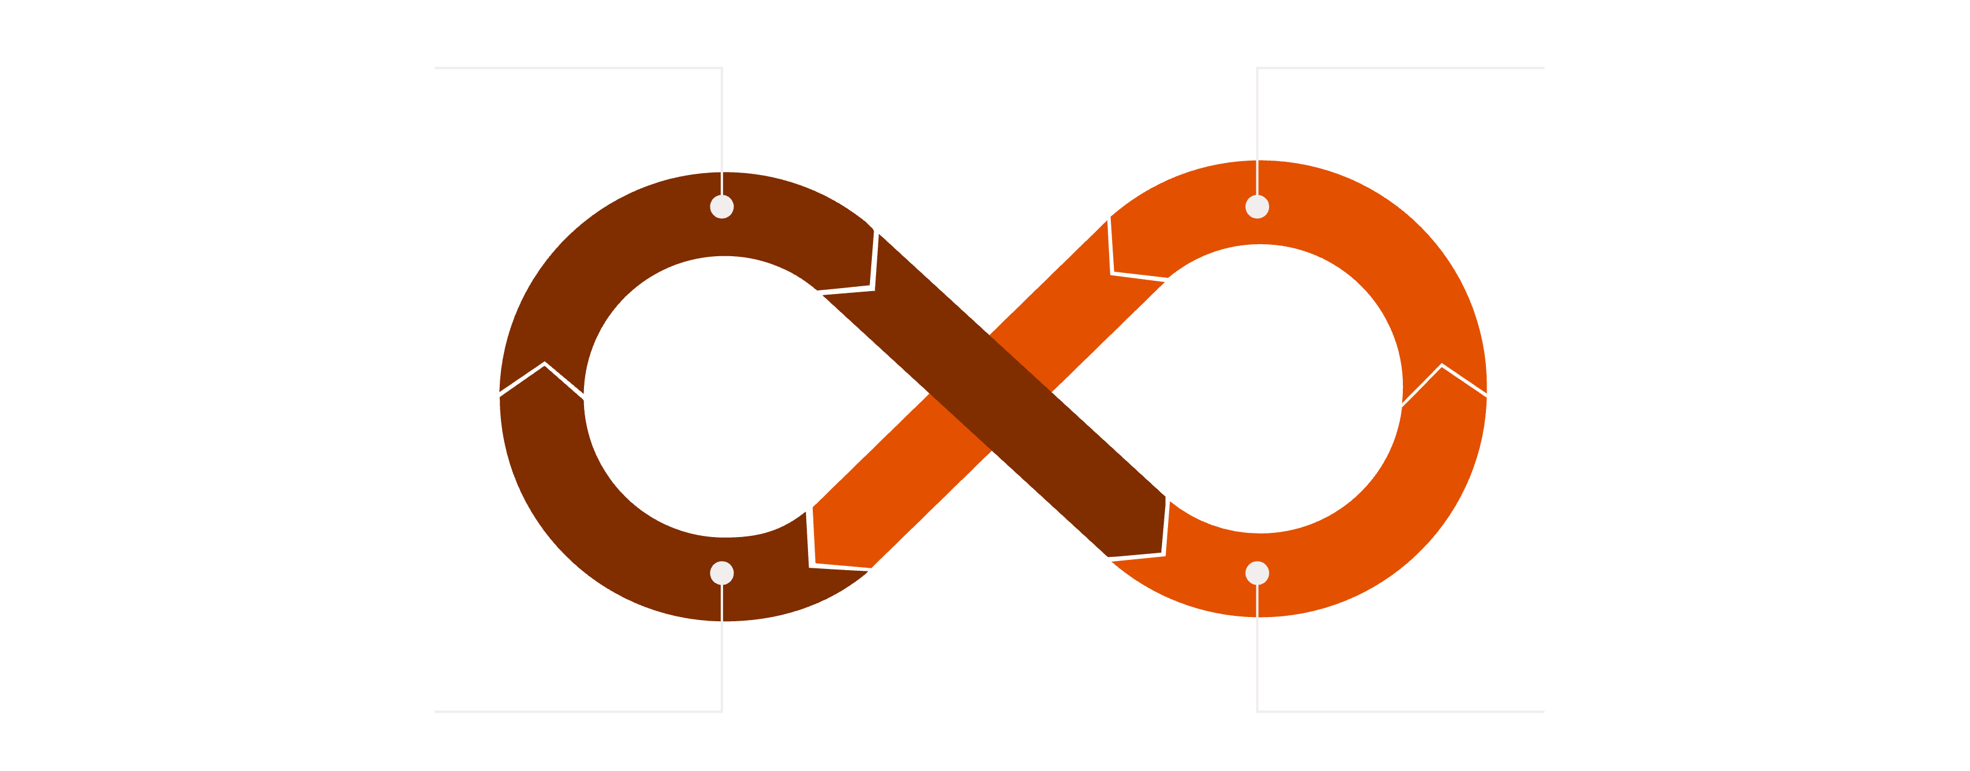
GAN Architecture
Generator Creates Fakes
Discriminator Classifies
Update Networks
Compute Feedback Loss
The Generator produces synthetic samples from random noise, while the Discriminator evaluates whether each sample is real or fake. This feedback loop drives iterative improvement in both networks, until an equilibrium is reached where the generated data becomes indistinguishable from real data and the Discriminator can no longer reliably differentiate between the two.

Slide 6
Why GANs for Computer Vision?
Learning Complex Visual Structure
Unsupervised by Nature
The Creative Machine Philosophy
No labeled data is required. The adversarial signal itself is the supervision. This unlocks training on vast unlabeled image corpora at scale.
GANs capture high-dimensional, hierarchical patterns in pixel space—such as textures, edges, lighting, and semantics—without being explicitly told what to look for.
GANs show a simple but powerful idea: a system doesn’t need to be told the rules of reality—it can learn them on its own through competition.
The generator doesn’t directly see real data; it improves by learning from the discriminator’s feedback. This is similar to how people learn and create—by trying, getting feedback, and improving over time.

Slide 7
Applications of GANs in Computer Vision
Image Generation
Image-to-Image Translation
Synthesizing photorealistic faces, scenes, and objects from noise — enabling creative tools and dataset construction.
Converting between visual domains: day ↔ night, sketch ↔ photo, satellite ↔ map, without paired examples.
Super Resolution
Data Augmentation
Recovering high-frequency detail from low-resolution inputs — critical in medical imaging and satellite analysis.
Generating rare or minority class samples to combat class imbalance and improve model generalization.

Slide 8
DCGAN — Deep Convolutional GAN
DCGAN, introduced by Alec Radford and colleagues in 2015, replaced fully connected layers with convolutional (and strided convolution) layers. This made GANs much more stable to train and allowed them to scale better to image data.
Earlier GANs used fully connected layers (like flattening an image into a long list of numbers)
DCGAN used convolutions (looking at small patches of the image, like edges, textures)
Use Cases
Bedrooms → generates new room designs that don’t exist Faces → creates fake human faces that look real
Add “smile” → face becomes smiling
Add “glasses” → person gets glasses
Transposed Convolutions
Batch Normalization
LeakyReLU + Tanh
Upsampling in the generator preserves spatial structure
Stabilizes gradients across deep layers
Prevents dead neurons; keeps output in image range

Slide 9
DCGAN — Use Cases
Medical Imaging: Often used to generate synthetic X-rays, MRIs, or CT scans. This helps researchers bypass privacy regulations
(like HIPAA) and overcome the scarcity of labeled medical data.
Addressing Class Imbalance: If you have 1,000 images of "healthy" plants but only 50 of "diseased" ones, a DCGAN can generate
thousands of synthetic diseased images to balance your training set.
Data Privacy: By training a model on synthetic data that mimics the statistical properties of real data, organizations can share datasets
without exposing sensitive personal information.
Autonomous Driving: Generating diverse weather conditions (fog, rain, snow) or rare road scenarios to train self-driving algorithms.

Slide 10
SRGAN & ESRGAN — Enhanced Super Resolution
The Core Innovation
Standard CNNs trained with pixel-wise MSE loss tend to produce blurry images because they try to match every pixel exactly. When there are multiple possible correct outputs, the model averages them, which smooths out fine details like edges and textures.
To overcome this, Photo-Realistic Single Image Super-Resolution Using a Generative Adversarial Network introduced SRGAN, which uses perceptual loss instead of just pixel comparison.
This loss is computed in the feature space of a pre-trained network like VGG network, allowing the model to focus on how realistic the image looks rather than exact pixel matching. As a result, SRGAN produces sharper, more detailed, and visually realistic images.
ESRGAN enhanced super-resolution by introducing Residual-in-Residual Dense Blocks(RRDB) and relativistic adversarial loss, leading to superior perceptual quality.

Slide 11
SRGAN & ESRGAN — Super Resolution
Perceptual Loss
Medical Imaging
Measures feature-space similarity rather than pixel distance — aligns with human visual perception
Enhancing MRI & CT resolution without increasing radiation dose — a clinically significant application
Surveillance & Forensics
Recovering fine detail from degraded or low-resolution footage

Slide 12
GAN Models Are Evolving
StyleGAN / StyleGAN2
GAN architectures that generate highly realistic images by controlling styles (like textures and features) at different layers for better quality and consistency.
cGAN
Conditional GAN — conditions both G and D on class labels or auxiliary information for targeted synthesis.
Pix2Pix
specific type of conditional GAN (cGAN) designed for image-to-image translation, where the model learns to map an input image (like a sketch) directly
to a corresponding output image (like a photo).
WGAN
Uses Wasserstein distance instead of JS divergence — significantly more stable training dynamics.
cycleGAN
CycleGAN (Cycle-Consistent Generative Adversarial Network) is a breakthrough in computer vision because it allows for unpaired image-to-image translation.

Slide 13
Unpaired Image-Image Translation Using cycleGAN
Citation
Jun-Yan Zhu*, Taesung Park*, Phillip Isola, and Alexei A. Efros. "Unpaired Image-to-Image Translation using Cycle-Consistent Adversarial Networks",
in IEEE International Conference on Computer Vision (ICCV), 2017.

Slide 14
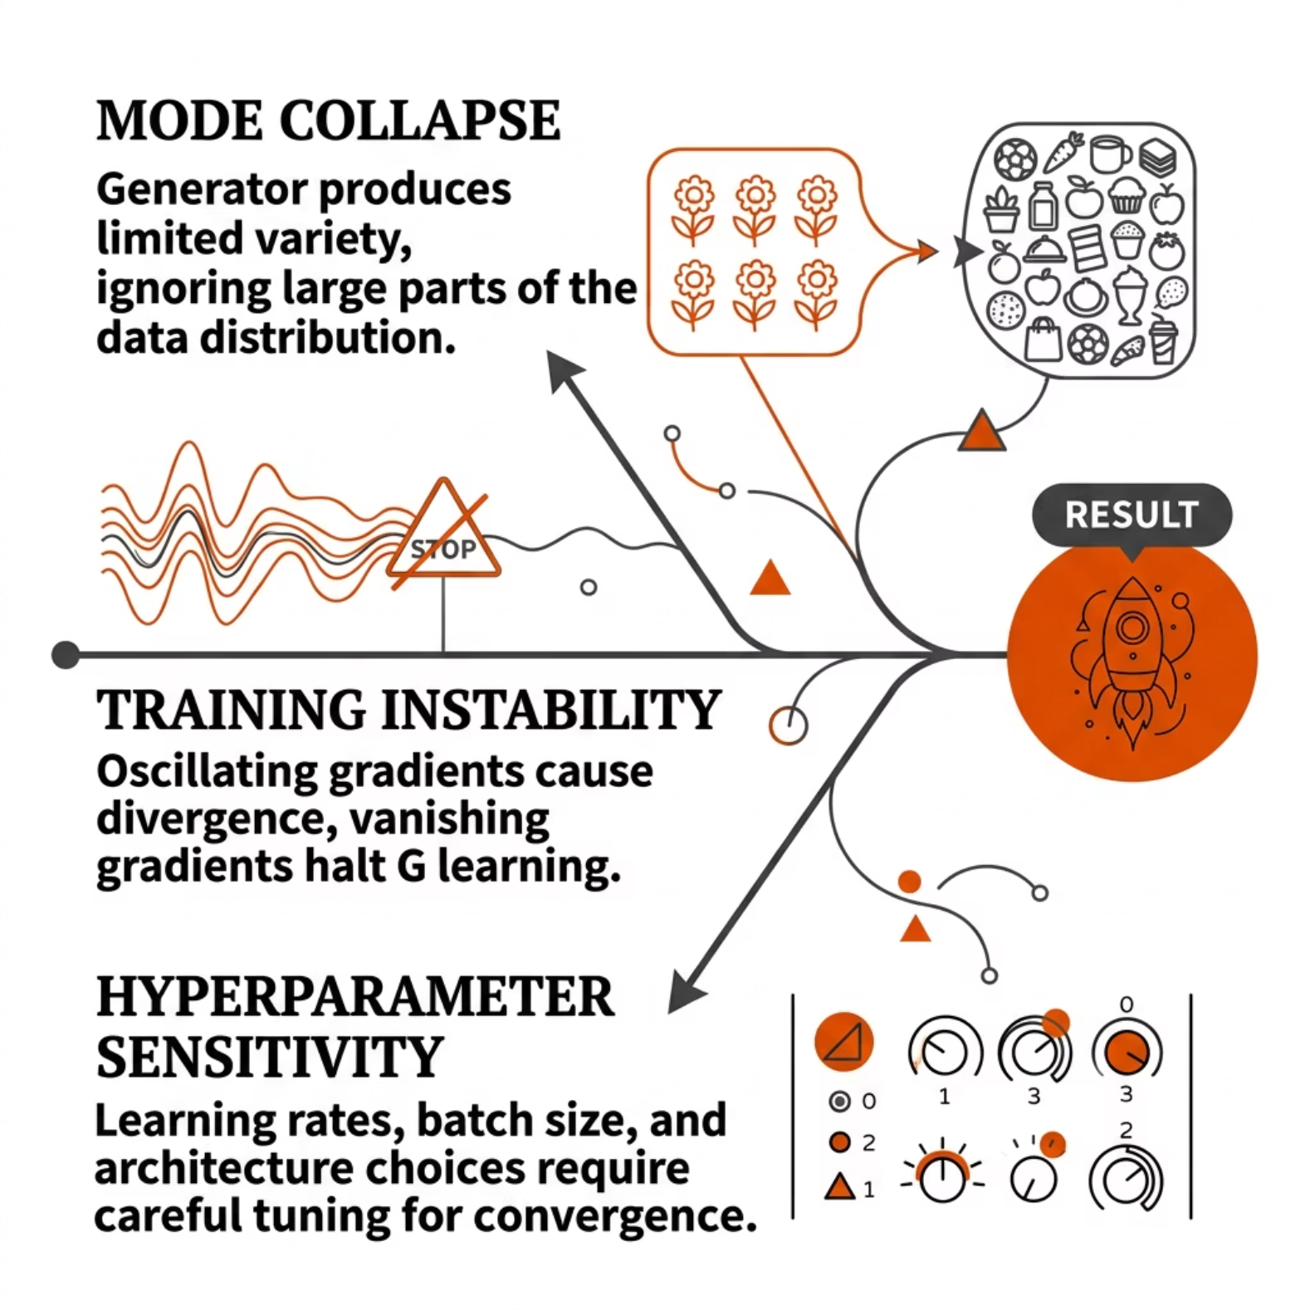

Training Challenges
Mode Collapse
Generator finds a small subset of outputs that fool D — lacks diversity. Addressed by minibatch discrimination, unrolled GANs.
Instability
G and D must stay balanced. If D wins too easily, G gets vanishing gradients. WGAN and spectral normalization mitigate this.
Hyperparameter Tuning
Learning rate ratios, architecture depth, and loss weights are highly sensitive and often problem-specific.

Slide 15

Key Takeaways
01
02
GANs Learn Without Labels
Architecture Matters
The adversarial objective provides self-supervised training signal — no human annotation required.
DCGAN, CycleGAN, SRGAN each solved a distinct CV problem through targeted architectural innovations.
03
04
Power Comes With Fragility
Real-World Impact
GANs are among the most expressive generative models — but mode collapse and instability demand careful engineering.
From medical imaging to creative AI, GANs are deployed across high-stakes computer vision domains today.
GANs remain a foundational framework — understanding them deeply is prerequisite to mastering modern generative vision models including diffusion and flow-based approaches.

